Slide 1
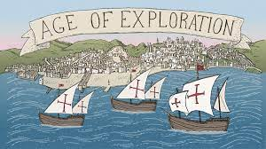
THE AGE OF EXPLORATION
Akshay. K
Grade IV A

Slide 2
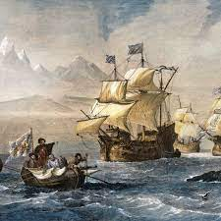
Need for the Exploration
During the mid Fifteenth and mid sixteenth centuries many Europeans set out to find a sea route to the east .
This is to trade with Asia because they needed cloth and spices.
The Portugal and Spain took the lead in discovering the sea route.
Henry, the Portuguese Prince started the voyage followed by others.

Slide 3
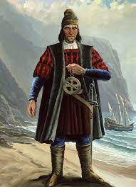
Bartholomew Diaz
In 1488, Bartholomew Diaz a Portuguese explorer reached the southern tip of Africa.
He couldn’t go further as the sea was rough hence, he named the place ‘Cape of Storms’.
Later it was named as ‘Cape of Good Hope’
because it offered explorers the hope of
reaching the East.

Slide 4
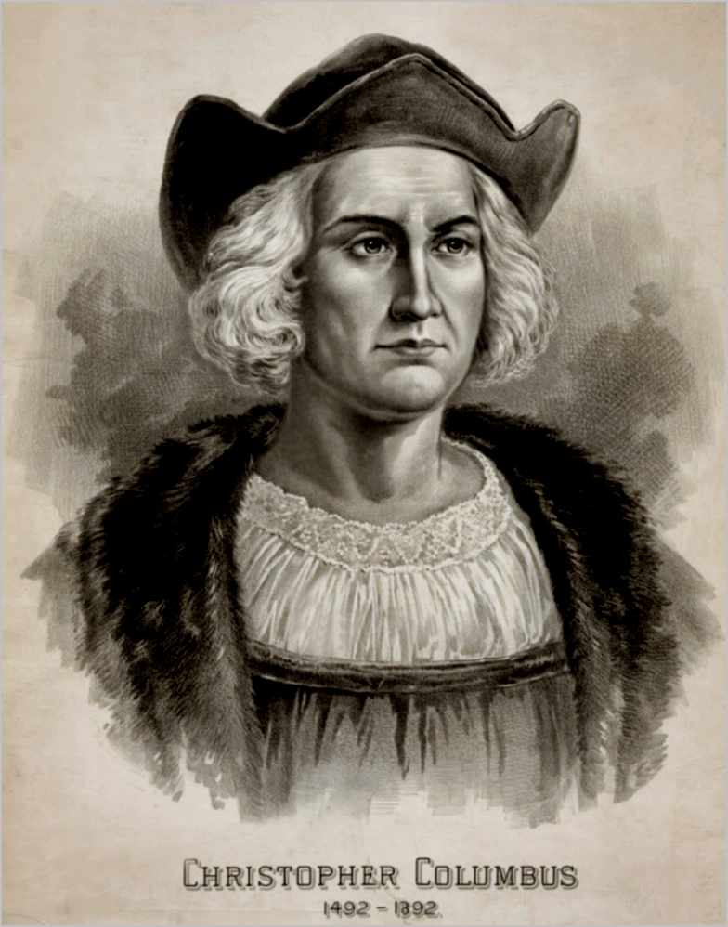
Christopher Columbus
In 1492, Columbus set out from Spain to find a sea route to the east.
He was an Italian explorer who sailed westwards instead of sailing eastwards and reached the Bahamas.
He crossed the Atlantic Ocean and discovered a new continent called ‘new World’.

Slide 5
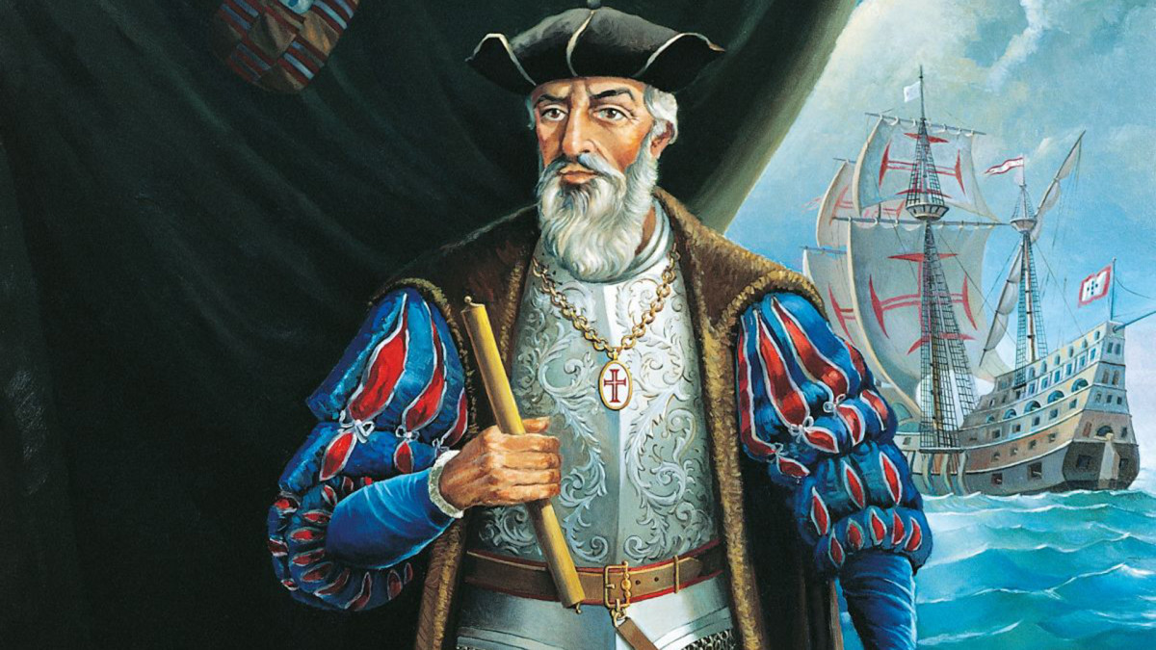
Vasco da Gama
Vasco da Gama was a Portuguese explorer. In 1497, he started his voyage from Lisbon in Portugal
In 1498 he reached Calicut. He was the first European to reach India by Sea.
He loaded his ships with spices which he later sold in Europe at a huge profit .
He made more trips to India.

Slide 6
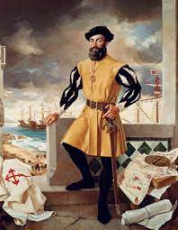
Ferdinand Magellan
Ferdinand Magellan was a Portuguese explorer.
He sailed round the world between 1519 and
1521.
He discovered a passage between the Atlantic and the Pacific oceans.
This passage was later named as Strait of Magellan.
He was the first to cross the Pacific ocean.

Slide 7
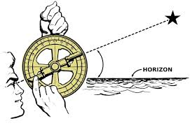
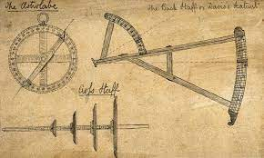
Instruments used by the sailors
The Sailors used many instruments to find their way in sea.
They used Maps to chart their course.
The ships had adjustable sails to move their ships faster by adjusting the sails to direction of the wind.
They used compass to find directions
They also used quadrant and astrolabe to know the location of their ship at sea.

